Slide 1
V2V Communication using Led- A Lifi Approach
M. Karthik 412514105044
C. Praveen Kumar 412514105075
Mr. S. Venkatasubramanian,
Assistant Professor,
Department of Electrical and Electronics Engineering,
Sri Sairam Engineering College,
Chennai

Slide 2
Abstract
DSRC technology is the current method of V2V communication and has similarities to 802.11a Wi-Fi which can be affected by multi-path and Doppler signal distortion, albeit to a lesser degree. And DSRC has range limitations, which would render it nearly useless in an emergency situation with no other vehicles within range.
The proposed system in this paper, uses the Light Fidelity technology overcoming the drawbacks of DSCR.
The driver remains in control at all the times and the vehicle will not automatically brake or steer. The system consists of Emergency electronic brake lights (EEBL), Blind spot warning (BSW), Lane change warning (LCW), Forward collision warning (FCW), Do not pass warning (DPSW), Intersection movement assist (IMA) and Right Turn Assist (RTA).
With the high scalability of this system, every vehicle on the road communicates with one another regardless of the model or manufacturer of the vehicles using sophisticated secured systems.

Slide 3
Objective
To assist drivers of the current generation vehicles for safer transport and to minimize the number of accidents by providing V2V communication.
Human senses are still better than the radars, lidars and cameras in driverless cars when it comes to things like classifying objects, edge detection, lane tracking and visibility range, according to a new report out of the University of Michigan’s Sustainable Worldwide Transportation research team. The study concluded human drivers are still better at reasoning, perception and overall sensing while driving compared to today’s driverless cars.
This is overcome by V2V communication to provide a performance closer to humans.
With LED automotive lighting, newer automobiles have the ability to communicate with each other (V2V communications) and with roadside infrastructure by quickly flashing their lights (LiFi) instead of using radio protocols.

Slide 4
Advantages of LiFi
➨The data transfer rate is higher. ➨It provides high amount of security as data communication is line of sight (LOS). Moreover lifi signal covers low region does not pass through the walls. This will avoid unwanted access of lifi signal by unauthorized persons. ➨The lifi devices consume low power for operation and hence used in IoT applications. ➨It uses optical spectrum and hence avoids already crowded RF spectrum. ➨As it operates on optical bands which are not harmful like RF spectrum. Hence there is no health concerns in LiFi based system.

Slide 5
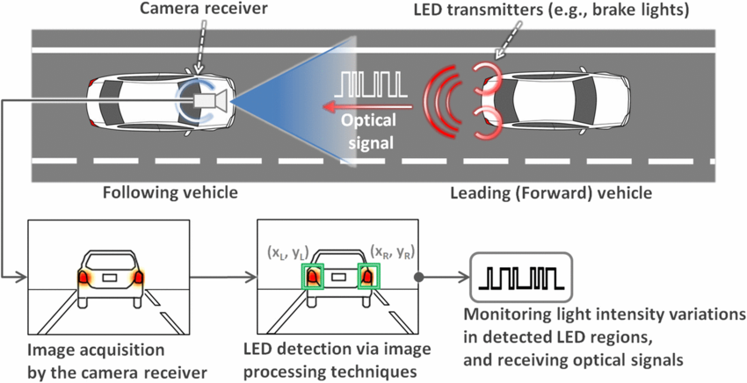
Block Diagram
CAR 1
DATA
DATA
MODULATION
LIGHT SOURCE
DATA
DATA
DEMODULATION
PHOTO DETECTOR
CAR 2

Slide 6
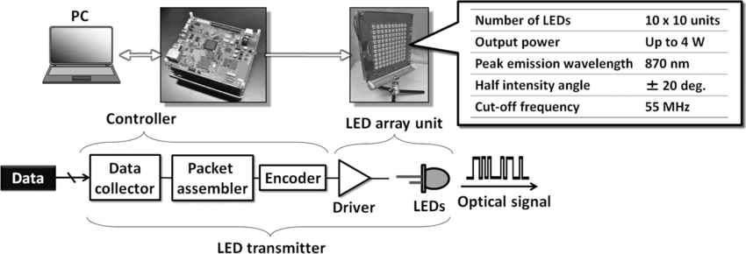
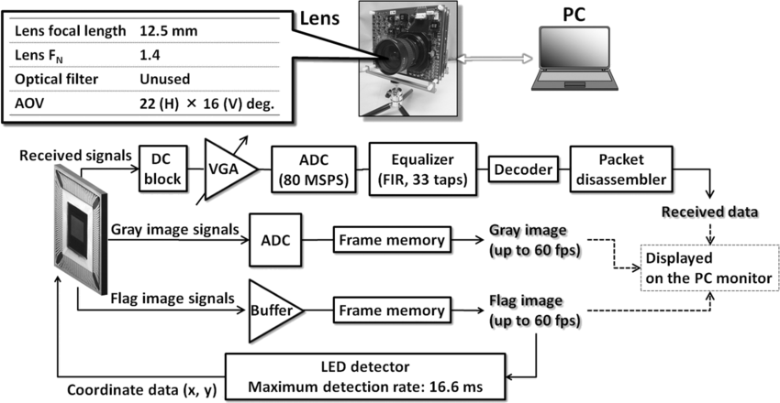
**The PC’s in the transmitter and Receiver block diagrams are connected to the cars communicating using V2V

Slide 7
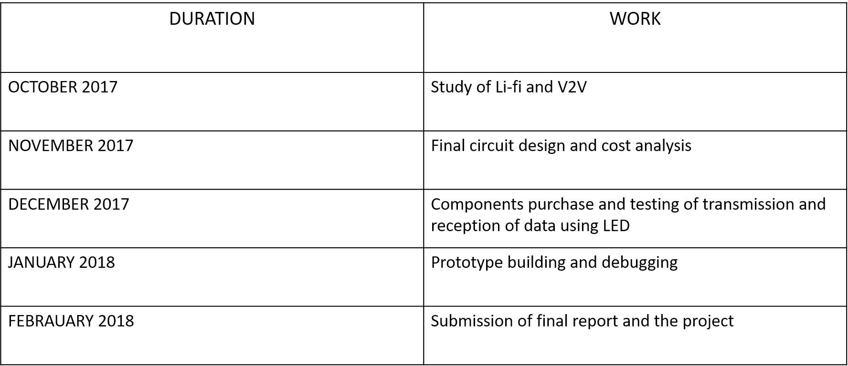
Work Plan

Slide 8
References:
https://www.researchgate.net/publication/265555753_Optical_Vehicle-to-Vehicle_Communication_System_Using_LED_Transmitter_and_Camera_Receiver
https://www.ted.com/talks/harald_haas_a_breakthrough_new_kind_of_wireless_internet
https://www.youtube.com/watch?v=POcQUTlOvZs
https://jalopnik.com/heres-why-v2v-is-so-enormously-important-for-driverless-1797475901

